Slide 1

Loblaws Digital Data Analysis

Slide 2
Objective
Predictive model that can accurately identify customers who are leaving the company (churn) based on the provided variables. This will help the company take proactive steps to retain these customers.
Perform exploratory analysis of the provided customer data to gain insights into the behavior and characteristics of the customers. Which includes analyzing patterns and trends in variables.

Slide 3
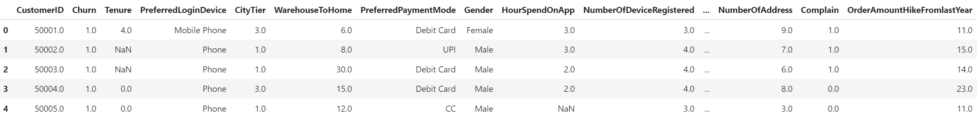
Dataset

Slide 4
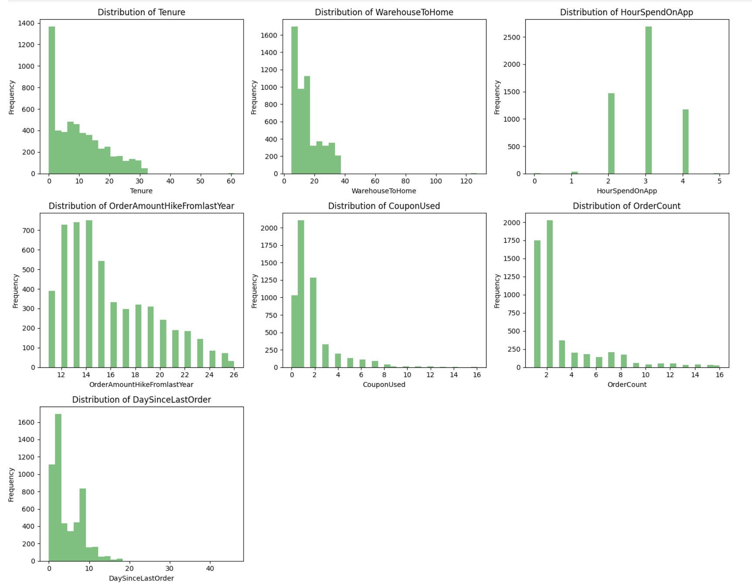
Visualizations
Tenure: This graph shows the frequency distribution of tenure values. The x-axis likely represents different tenure range, and the y-axis represents the frequency of employees falling within each range.
Warehouse To Home: This graph depicts the distribution of delivery time from the warehouse to customers’ homes.
Coupon Used: This graph likely displays the frequency distribution of coupon usage. The x-axis may represent different coupon counts, and the y-axis shows how often each count occurs.

Slide 5

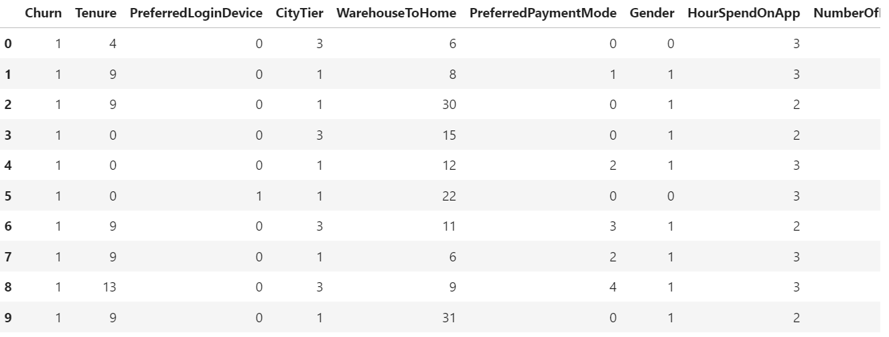
Pre-Processed Data

Slide 6
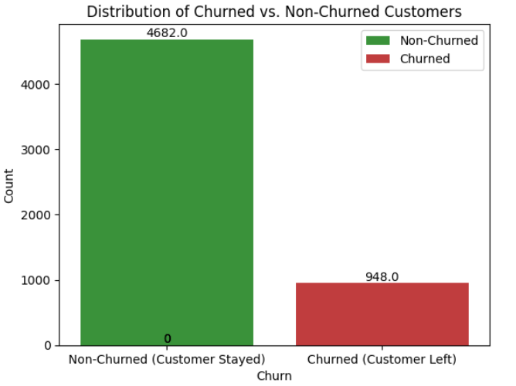

Slide 7
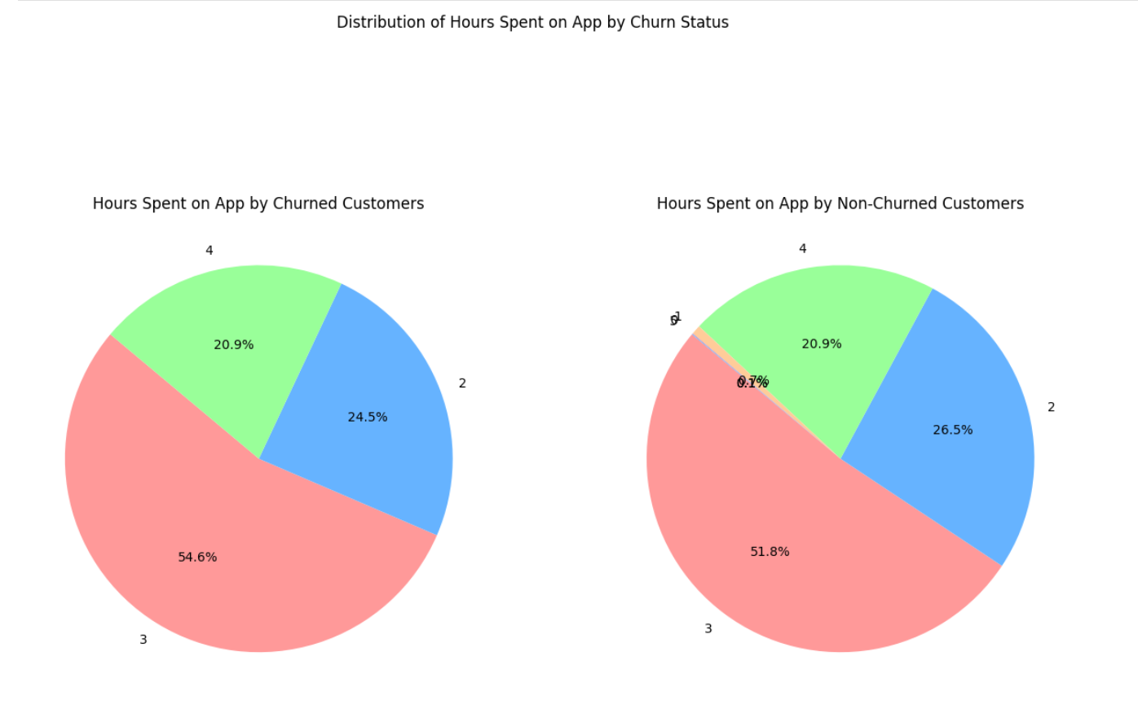

Slide 8
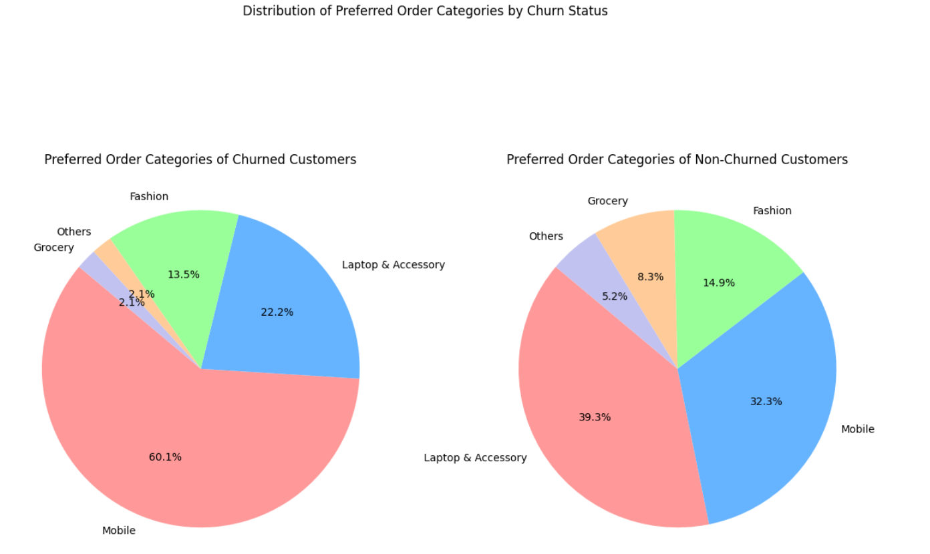

Slide 9
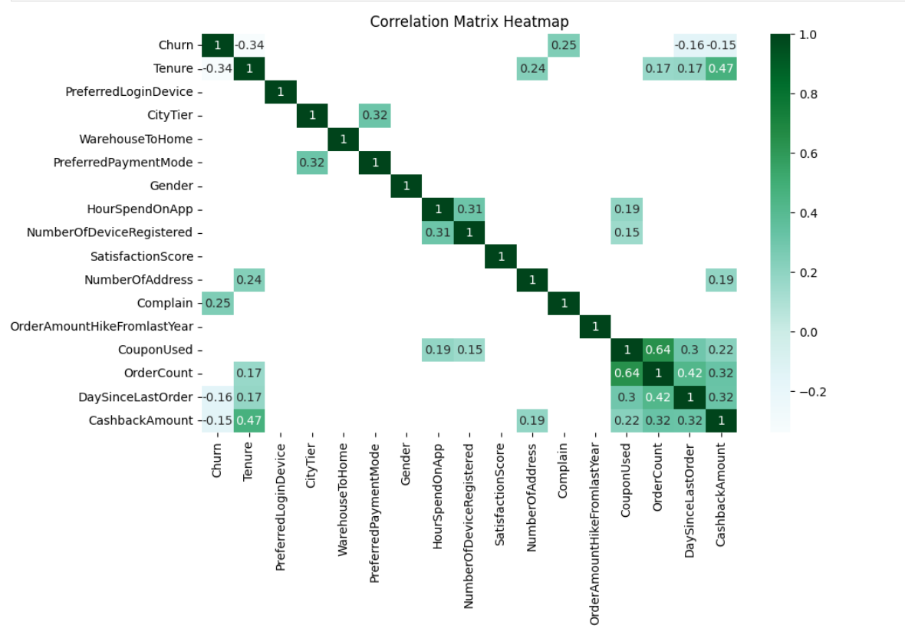

Slide 10
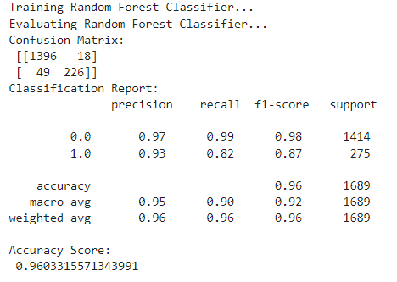
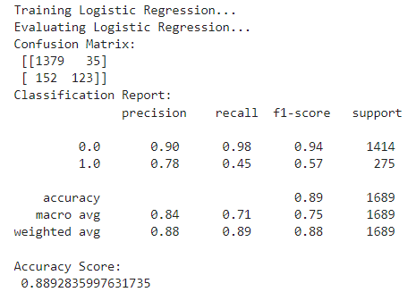
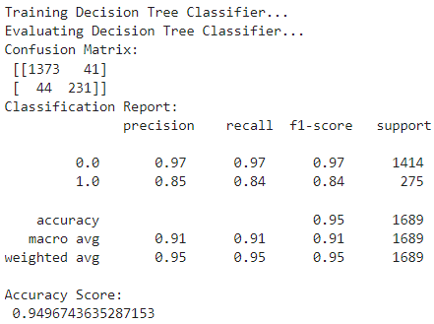
Models

Slide 11
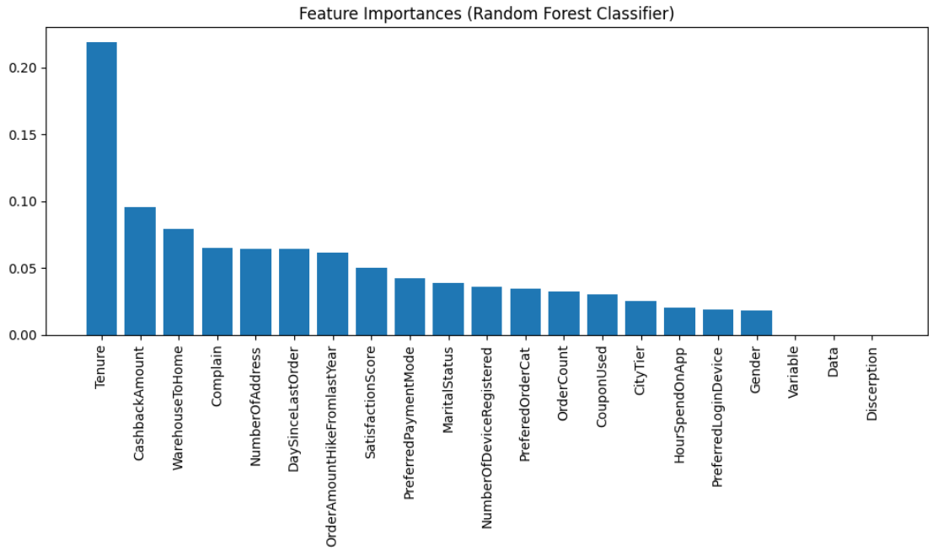

Slide 12

Recommendation With Analysis
Target High Value Customers.
Improve Complaint Handling.
Offer Personalized Incentives.
Customer Retention Strategies
Coupon and Promotion Strategies
Immediate Cashback and Rewards Programs

Slide 13

Thankyou

